Slide 2
Key points:

Slide 3
Content
What Is PoPAI
What Is “Excel PowerPivot” and “Excel Publisher”
Install Excel add-in - “Publisher” for PoPAI
Enable “Excel PowerPivot”
Create a PowerPivot table
Edit a PowerPivot table
Publish a PowerPivot Table

Slide 4
What is PoPAI
Web application
Imports transforms and presents data
Charts, Tables, Graphs..

Slide 5
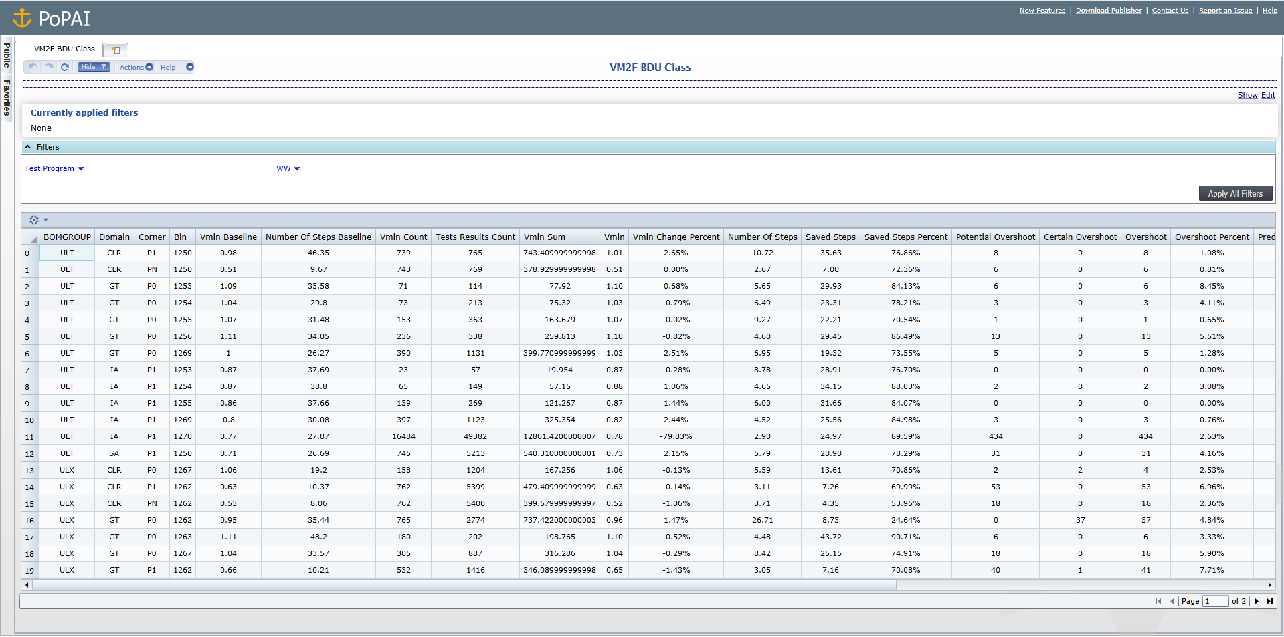

Slide 6
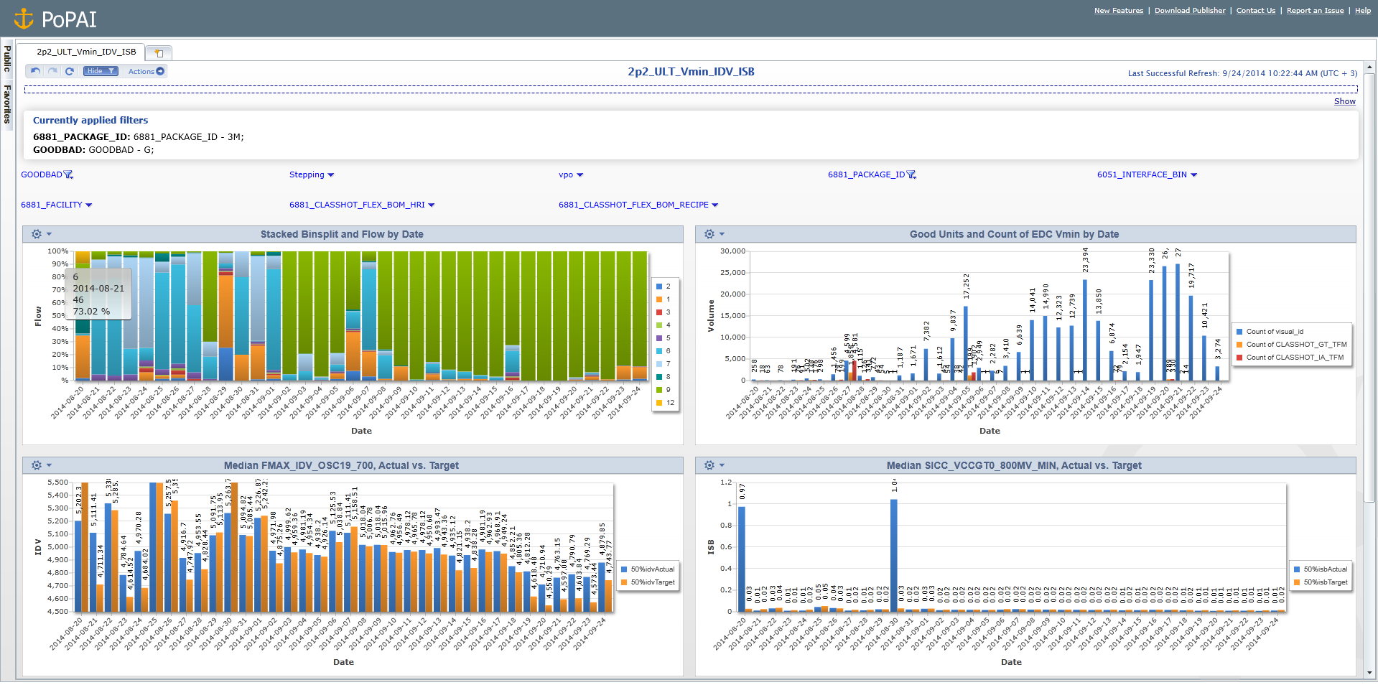

Slide 7
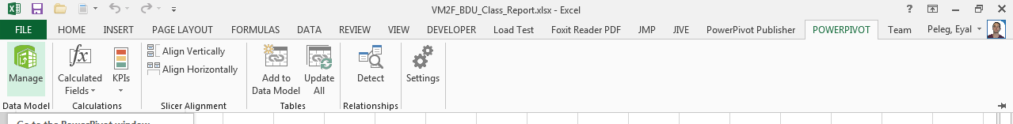
Create a PowerPivot table

Slide 8
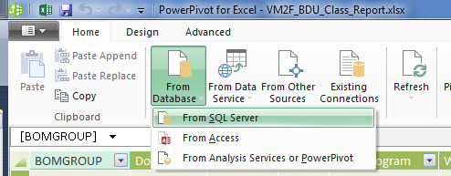

Slide 9
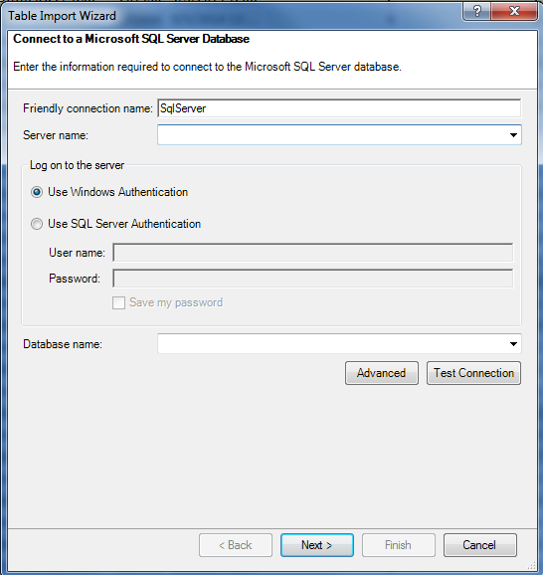

Slide 10
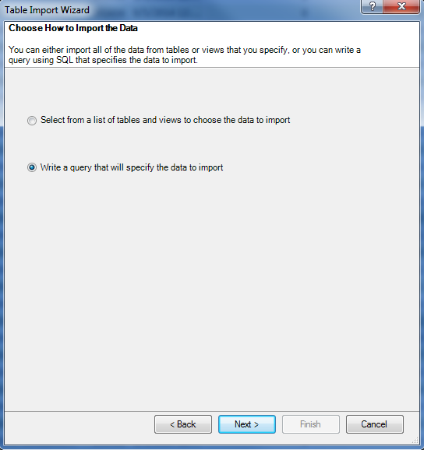

Slide 11
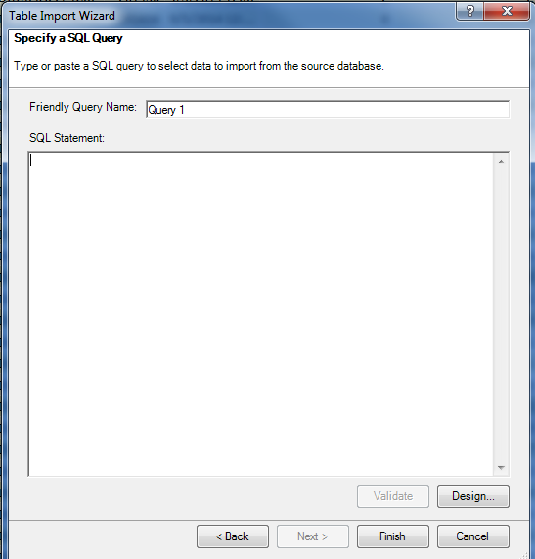

Slide 12
SET NOCOUNT ON;

Slide 13
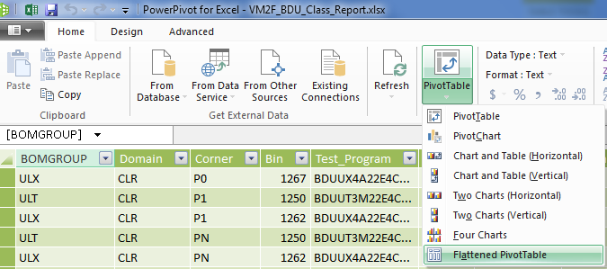

Slide 14
Edit a PowerPivot table

Slide 15
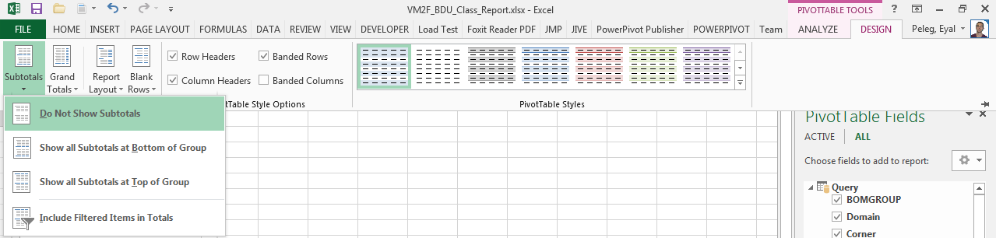

Slide 16
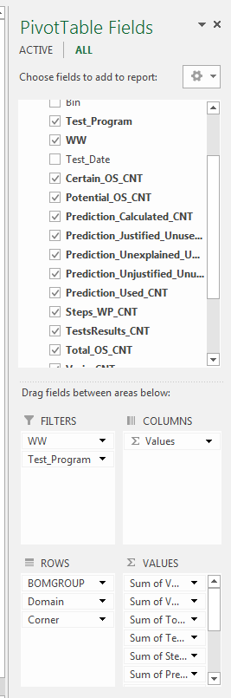

Slide 17
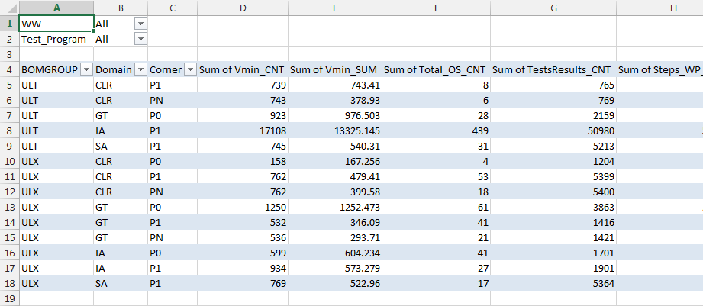

Slide 18
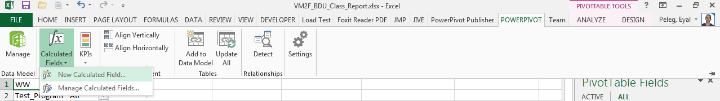

Slide 19
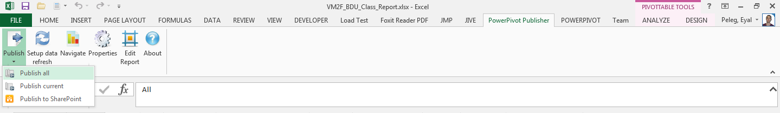
Publish the PowerPivot

Slide 20
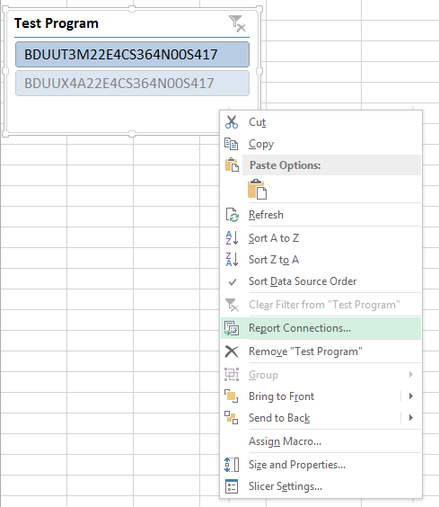
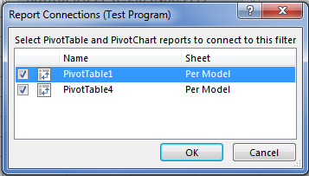
Set slicers

Slide 21
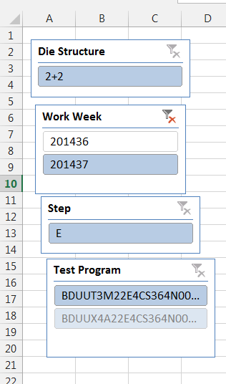
Slicers locations

